Slide 1
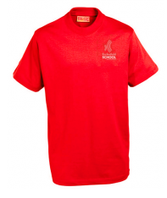
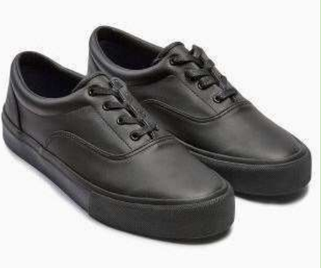
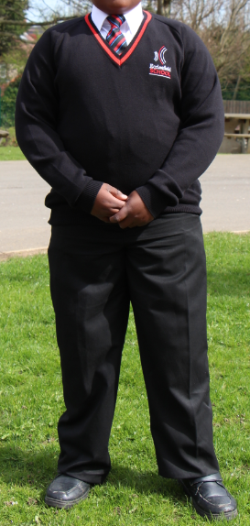
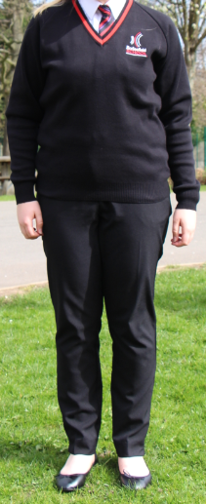
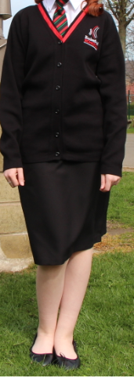
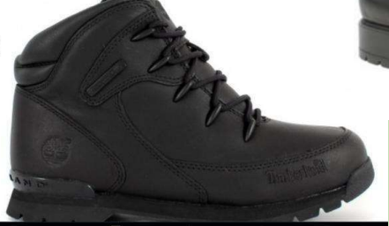
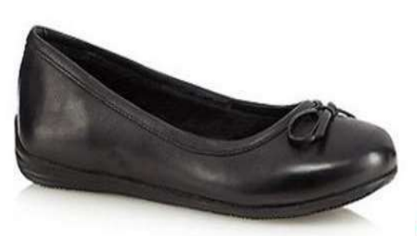
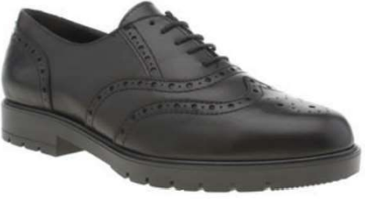
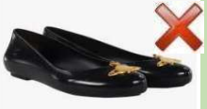
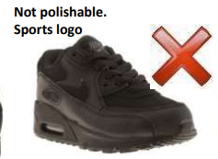
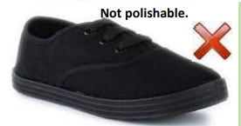
Ecclesfield School Uniform
Gold adornments
General
JUMPER – At the discretion of the Headteacher, jumpers may be removed in hot weather. Pupils will be notified of this by their Tutor.
HAIR & NAILS – Hair colour must be natural and no extreme haircuts ie Mohican, patterns. Nails must be no longer than the top of fingers. False nails are not permitted. Nail polish must be neutral/natural colours. Students should not wear false eyelashes.
JEWELLERY & MAKE-UP – One pair of studs may be worn. No other facial jewellery may be worn. Tongue/lip/nose piercings are not permitted. Wristbands and bracelets are not permitted. Students may wear one ring. Necklaces are not to be worn.
Uniform
TROUSERS – Plain black, straight-legged trousers. Trousers should be loose fitting from hip to ankle. No jeans, leggings, tight fitting trousers are permitted. Please note that many high-street retailers will market their trousers as ‘school – ready’. Please always check that it is compliant with School policy before purchasing.
SHIRT – Plain, white, stiff-collared shirt must be worn. Top buttons must be fastened at all times. Shirts may have full or short sleeves.
SHOES – Black formal shoes/boots. No spots logos at all (even if they are black). No adornments on the shoe. Shoes should be polishable ie not suede or canvas.
COAT – Waterproof coats should be worn to school. Hoods should be down inside the building.
TIE - House ties should be worn at all times.
Notes:
Title of your session

Slide 2
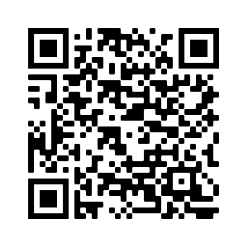
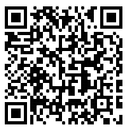
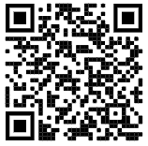
Ecclesfield School Uniform
PE Uniform
PE TOP – Red PE t-shirt with school logo..
SWEATSHIRT– Black school PE sweatshirt with school logo..
TRAINERS – Lace up trainers suitable for high impact exercise should be worn.
HEALTH & SAFETY – all piercings must be removed during PE lessons. Long hair must be tied back.
Support
As a School, we endeavour to support all families so that uniform is not a barrier to attending. Ecclesfield School is proud to work alongside Ecclesfield Parish Council and their Uniform Swap Shop who will help to provide uniform for students. Equally, given the current rise in cost of living, we as a school, are happy to help wherever we can do so. Please contact your child’s Form Tutor for more information on how to access financial support to purchase uniform and equipment so that your child can achieve their best at School.
Link to full uniform brochure
Link to uniform supplier
Link to Uniform Swap Shop
Notes:
Title of your session

